Slide 1
CHAT N’ CHEW!
2nd Annual Workshop
For the Enhancement of Cross-cultural Communication
Wednesday, March 27, 2019
5:30pm - 7:30pm
Keys to Relationship Success
Dr. Ciloue Cheng Stewart & Associates
Co-Sponsored by Habif Health And Wellness Center
& Office For International Students And Scholars
Washington University in St. Louis

Slide 2
Scenarios and Discussions: What Do You Think?
A. Romantic Relationships
1. Communicating Needs/Concerns
2. Dealing with Differences
B. Relationships in Academic Settings
1. Group Discussions
2. Advisor/Advisee Communication

Slide 3
II. Problematic Romantic Relationship Dynamics
Examples of Common but Unhealthy Relational Patterns:
The Elusive/The Chaser; The Angry Parent/The Rebel Child; The Hold-Back/Scream-Loud; The Dominant/Submissive Pattern; The Co-Dependent Pattern...etc.

Slide 4
B. The 4 Horsemen of the Apocalypse: Conflict Approaches that Hurt Relationships (Gottman, 1999)
Criticism
Contempt
Defensiveness
Stonewalling

Slide 5
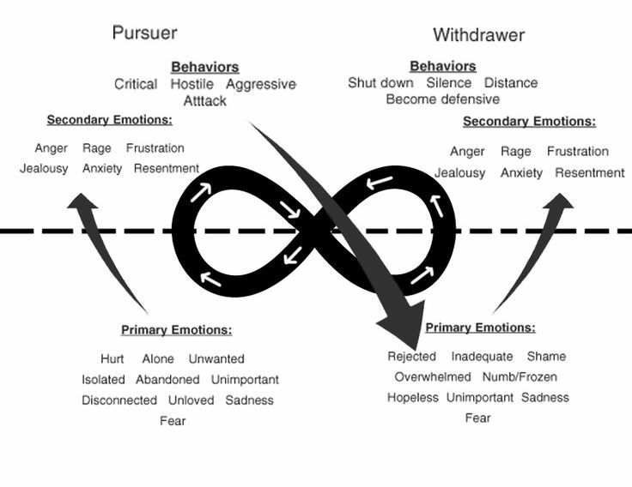
C. Beneath Words and Behaviors… (Johnson)
Concepts: Dr. Susan Johnson
Page contribution: Dr. Karolyn Senter

Slide 6
C. The Antidotes
Criticism --> Gentle Start-up a. Use I statement b. Focus on your need
Contempt --> Building a culture of appreciation & respect
Defensiveness --> Take responsibility
Stonewalling --> Physiological Self-Soothing

Slide 7
III. Keys to Romantic Relationship Success
The Foundations
Trust (Safety, Responsiveness & Accessibility)
Not a “Zero-Sum,” but a “Cooperative-Gain” Game
B. 7 Research-based Principles for Making Romantic Relationships Work (Gottman, 1999)
1. Enhance your love maps 2. Nurture your fondness and admiration 3. Turn toward each other instead of away

Slide 8
4. Let your partner influence you
5.Solve your solvable problems
Soften your startup
Make and receive “repair attempts”
Soothe yourself and then your partner
Compromise
Remember to be tolerant of each other’s faults
6. Overcome Gridlock
7. Create shared meaning

Slide 9
IV. Be Your Own Advocate in Academic Settings
Culturally-based assumptions in the western academia 1. Be OK with myself: My cultural differences do not make me any LESS! 2. My proficiency with my 2nd language is just a means 3.The extraverted American classroom culture can be tough for domestic students as well 4. Disagreement is A-Ok. 5. Collaboration as equals is desirable. Dominance is not. Nor is quiet submission.

Slide 10
B. Desirable classroom behaviors (in the US) that get better with practice 1. Raise questions 2. Think out loud 3. Let others know my reasoning, not just my conclusion 4. Have a win-win approach to teamwork 5. Speak up, just to participate 6. Humor. Don’t take yourself too seriously.

Slide 11
C. Communicating with Professors/Advisors
It is not one-directional.
There is mutuality. Am I getting what I need?
When there’s miscommunication, the responsibility is shared.
Before an important meeting: know my own goals
After the meeting: I will follow up
Have realistic expectations of myself and the professor
Get support and guidance. Don’t let my emotions make decisions for me.

Slide 12
D. Communication Styles
Force - My Way (Aggressive)
Accommodate - Your Way (Passive)
Collaborate - Our Way (Assertive)
Avoidance - NO WAY

Slide 13
IV. Questions & Comments

Slide 14
V. Some Recommended Readings...
Carnegie (1981). How to Win Friends and Influence People Chapman (1995). The Five Love Languages Cuddy (2015). Presence: Bringing Your Boldest Self to Your Biggest Challenges Gottman (1994). Why Marriages Succeed or Fail Gottman (1999). The Marriage Clinic Gottman (1999). Seven Principles for Making Marriages Work Gottman (2001). The Relationship Cure Gottman (2011). The Science of Trust: Emotional Attunement for Couples Harris (2004). I’m OK -- You’re OK. Johnson (2019). Attachment Theory in Practice: Emotionally Focused Therapy (EFT) with Individuals, Couples, and Families Patterson (2000 ). The Assertiveness Workbook: How to Express Yourself and Stand Up for Your Ideas at Work and in Relationships. Phillips (2017 ). Overcoming Conflict: How to Deal with Difficult People and Situations

